Slide 1

Chapter 8. Tests of Hypotheses Based on a Single Sample
Weiqi Luo (骆伟祺)
School of Data & Computer Science
Sun Yat-Sen University
Email：luoweiqi@mail.sysu.edu.cn

Slide 2
Chapter 8: Tests of Hypotheses Based on a Single Sample
8.1. Hypotheses and Test Procedures
8.2. Tests About a Population Mean
8.3. Tests Concerning a Population Proportion
8.4. P-Values
8.5. Some Comments on Selecting a Test Procedure

Slide 3
8.1. Hypotheses and Test Procedures
A parameter can be estimated from sample data either by a single number (Chap 6. a point estimate) or an entire interval of plausible values (Chap 7. a confidence interval).
However, the objective of an investigation is not to estimate a parameter but to decide which of two contradictory claims about the parameter is correct.
Methods for accomplishing this comprise the part of statistical inference called hypothesis testing

Slide 4
8.1. Hypotheses and Test Procedures
A statistical hypothesis, or just hypothesis, is a claim or assertion either about the value of a single parameter (population characteristic or characteristic of a probability distribution), about the values of several parameters, or about the form of an entire probability distribution.
In any hypothesis-testing problem, there are two contradictory hypotheses under consideration.
The objective is to decide, based on sample information, which of the two hypotheses is correct

Slide 5
8.1. Hypotheses and Test Procedures
The null hypothesis, denoted by H₀, is the claim that is initially assumed to be true. The alternative hypothesis, denoted by H_{a}, is the assertion that is contradictory to H₀.
The null hypothesis will be rejected in favor of the alternative hypothesis only if sample evidence suggests that H₀ is false. If the sample does not strongly contradict H₀, we will continue to believe in the plausibility of the null hypothesis.
The two possible conclusions from a hypothesis-testing analysis are then reject H₀ or fail to reject H₀.

Slide 6
8.1. Hypotheses and Test Procedures
In our treatment of hypothesis testing, H₀ will generally be stated as an equality claim, e.g., H₀: θ = θ₀
Let p denote the true proportion of defective boards resulting from the changed process. The suggested alternative hypothesis was H_{a}: p<0.10 , the claim that the defective rate is reduced by the process modification. A natural choice of H₀ in this situation is the claim that H₀: p ≥ 0.10 according to which the new process is either no better or worse than the one currently used.
We will instead consider H₀: p = 0.10 vs. H_{a}: p<0.10 .
The rationale for using this simplified null hypothesis is that any reasonable decision procedure for deciding between H₀ and H_{a} will also be reasonable for deciding between p≥0.10 and H_{a}

Slide 7
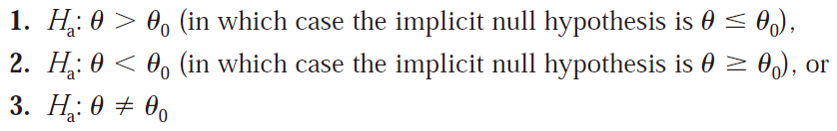
8.1. Hypotheses and Test Procedures
The alternative to the null hypothesis H₀: θ = θ₀ will look like one of the following three assertions:
The number θ₀ that appears in both H₀ and H_{a} (separates the alternative from the null) is called the null value.

Slide 8
8.1. Hypotheses and Test Procedures
A test of H₀: p =0.1 versus H_{a}: p<0.1 in the circuit board problem might be based on examining a random sample of n=200 boards.
Let X denote the number of defective boards in the sample, a binomial random variable; x represents the observed value of X. If H₀ is true, E(x) = np = 20, whereas we can expect fewer than 20 defective boards if H_{a} is true. A value x just a bit below 20 does not strongly contradict H₀, so it is reasonable to reject H₀ only if x is substantially less than 20. one such test procedure is to reject H₀ if x ≤ 15 and not reject H₀ otherwise.

Slide 9
8.1. Hypotheses and Test Procedures
A test of hypotheses is a method for using sample data to decide whether the null hypothesis should be rejected.
A test procedure is specified by the following:
A test statistic, a function of the sample data on which the decision (reject H₀ or do not reject H₀) is to be based
A rejection region, the set of all test statistic values for which H₀ will be rejected
The null hypothesis will then be rejected if and only if the observed or computed test statistic value falls in the rejection region.

Slide 10
8.1. Hypotheses and Test Procedures
Based on the Errors
Assume H₀ is true
Define a test statistic
Define a rejection region
Yes
Sample data
a test statistic
Fall in rejection region?
Reject H₀
No
Do not reject H₀

Slide 11
8.1. Hypotheses and Test Procedures
Two types of Errors in Hypothesis Testing
A type I error consists of rejecting the null hypothesis H₀ when it is true. A type II error involves not rejecting H₀ when H₀ is false.
A good procedure is one for which the probability of making either type of error is small.
Because H₀ specifies a unique value of the parameter, there is a single value of α. However, there is a different value of β for each value of the parameter consistent with H_{a}. The choice of a particular rejection region cutoff value fixes the probabilities of type I and type II errors.
 | H₀ is true | H₀ is false
Reject H₀ | Type I error α
Do not reject H₀ |  | Type II error β

Slide 12
8.1. Hypotheses and Test Procedures
Example 8.1
A certain type of automobile is known to sustain no visible damage 25% of the time in 10-mph crash tests. A modified bumper design has been proposed in an effort to increase this percentage. Let p denote the proportion of all 10-mph crashes with this new bumper that result in no visible damage. The hypotheses to be tested are H₀: p=0.25 (no improvement) versus H_{a}: p>0.25 .
The test will be based on an experiment involving n=20 independent crashes with prototypes of the new design. Intuitively, H₀ should be rejected if a substantial number of the crashes show no damage.

Slide 13
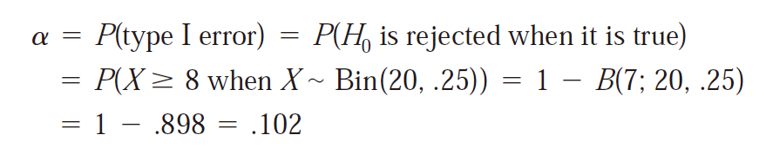
8.1. Hypotheses and Test Procedures
Example 8.1 (Cont’)
Test statistic: X = the number of crashes with no visible damage
Rejection region: R₈ = {8,9,10,…,19,20}; that is reject H₀ if x>=8, where x is the observed value of the test statistic.
When H₀ is true, X has a binomial probability distribution with n=20, p = 0.25
That is, when H₀ is actually true, roughly 10% of all experiments consisting of 20 crashes would result in H₀ being incorrectly rejected (a type I error).

Slide 14
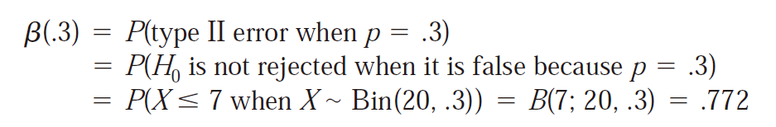
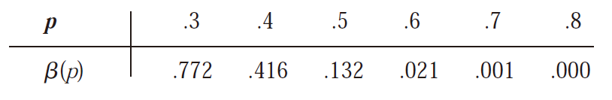
8.1. Hypotheses and Test Procedures
Example 8.1 (Cont’)
In contrast to α, there is not a single β. Instead, there is a different β for each different p that exceeds 0.25. For instance
When p is 0.3 rather than 0.25, roughly 77% of all experiments of this type would result in H₀ being incorrectly not rejected!
the greater the departure from H₀, the less likely it is that such a departure will not be detected.

Slide 15
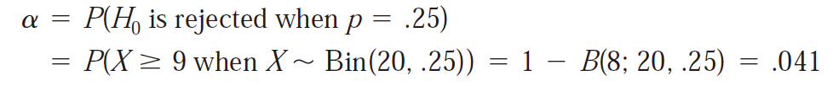
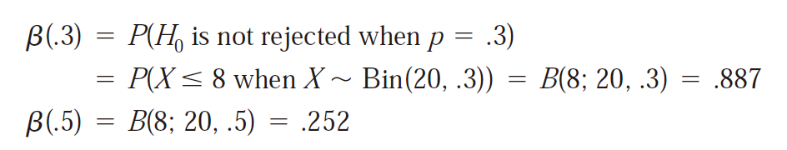
8.1. Hypotheses and Test Procedures
Example 8.3 (Ex. 8.1 continued)
Let us use the same experiment and test statistic X as previously described in the automobile bumper problem but now consider the rejection region R₉ = {9,10,…,19,20};
Since X still has a binomial distribution with parameters and p,

Slide 16

8.1. Hypotheses and Test Procedures
Example 8.2
The drying time of a certain type of paint under specified test conditions is known to be normally distributed with mean value 75 min and standard deviation 9 min. It is believed that drying times with an additive will remain normally distributed with δ =9. Because of the expense associated with the additive, evidence should strongly suggest an improvement in average drying time before such a conclusion is adopted.
Let μ denote the true average drying time when the additive is used.
H₀: μ = 75 versus H_{a}: μ <75
Experimental data is to consist of drying time form n = 25 test specimens. A reasonable rejection region has the form where the cutoff value c is suitably chosen, e.g., c = 70.8.

Slide 17
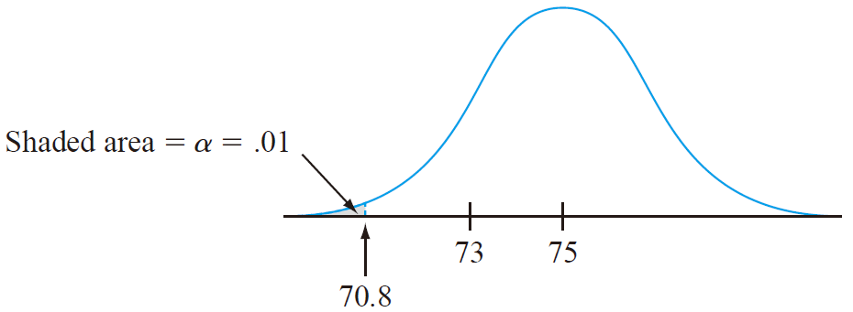
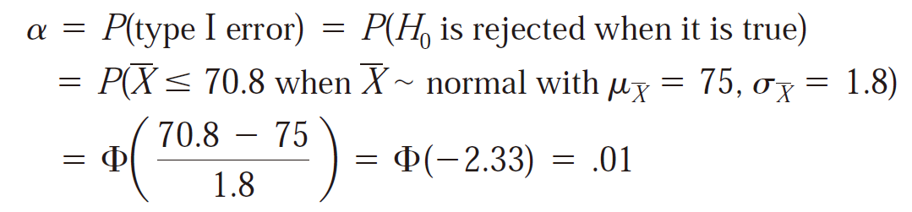
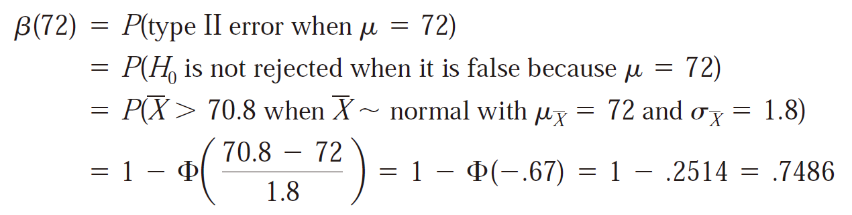
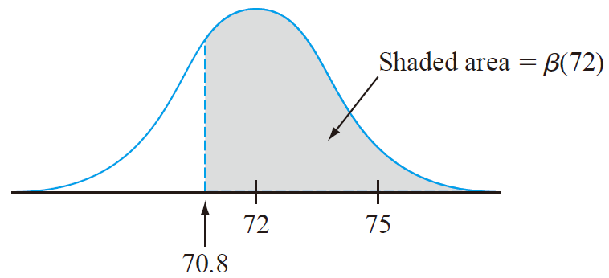
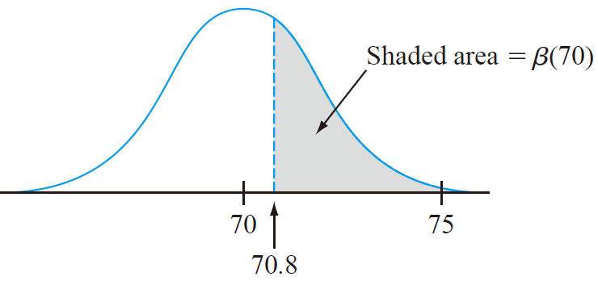
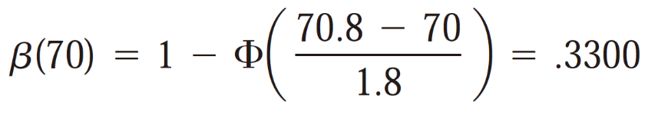
8.1. Hypotheses and Test Procedures
Example 8.2 (cont’)

Slide 18

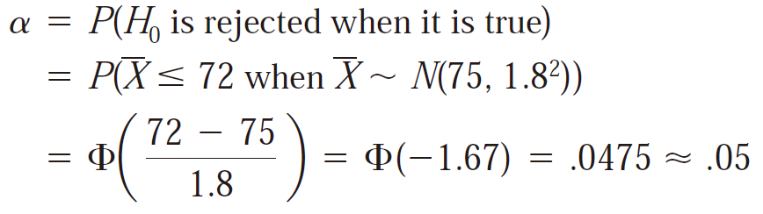
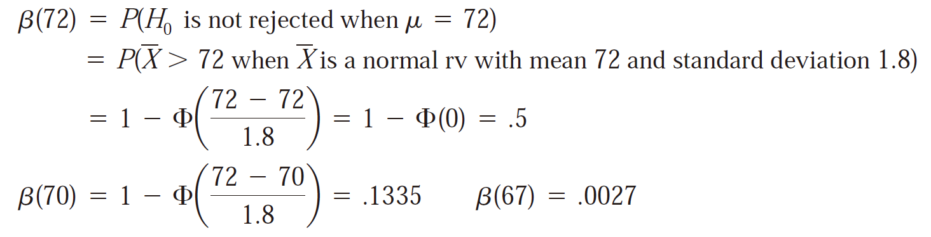
8.1. Hypotheses and Test Procedures
Example 8.4 (Ex. 8.2 continued)
The use of cutoff value c=70.8 in the paint-drying example resulted in a very small value of α =0.01, but rather large β’s. Consider the same experiment and test statistic with the new rejection region

Slide 19
8.1. Hypotheses and Test Procedures
Proposition
Suppose an experiment and a sample size are fixed and a test statistic is chosen. Then decreasing the size of the rejection region to obtain a smaller value of α results in a larger value of β for any particular parameter value consistent with H_{a}.
This proposition says that once the test statistic and n are fixed, there is no rejection region that will simultaneously make both α and all β’s small. A region must be chosen to effect a compromise between α and β.
A type I error is usually more serious than a type II error.
In the level α test, we specify the largest value of α (significance level) that can be tolerated and find a rejection region.
Typical α 0.10, 0.05, and 0.01

Slide 20

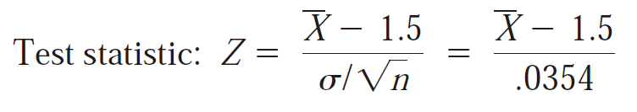


8.1. Hypotheses and Test Procedures
Example 8.5
Again let μ denote the true average nicotine content of brand B cigarettes. The objective is to test H₀: μ = 1.5 versus H_{a}: μ >1.5 based on a random sample X₁, X₂, … X₃₂ of nicotine content. Suppose the distribution of nicotine content is known to be normal with δ = 0.2.
Rather than use itself as the test statistic, let’s standardize , assuming that H₀ is true.
α = 0.05,

Slide 21
8.1. Hypotheses and Test Procedures
Homework
Ex. 9, Ex.11, Ex.14

Slide 23
8.2. Tests About a Population Mean
Case I: A Normal Population with Known δ
Case II: Large-Sample Tests
Case III: A Normal Population Distribution
The null hypothesis in all three cases will state that μ has a particular numerical
value, the null value, which we will denote by μ₀.

Slide 24
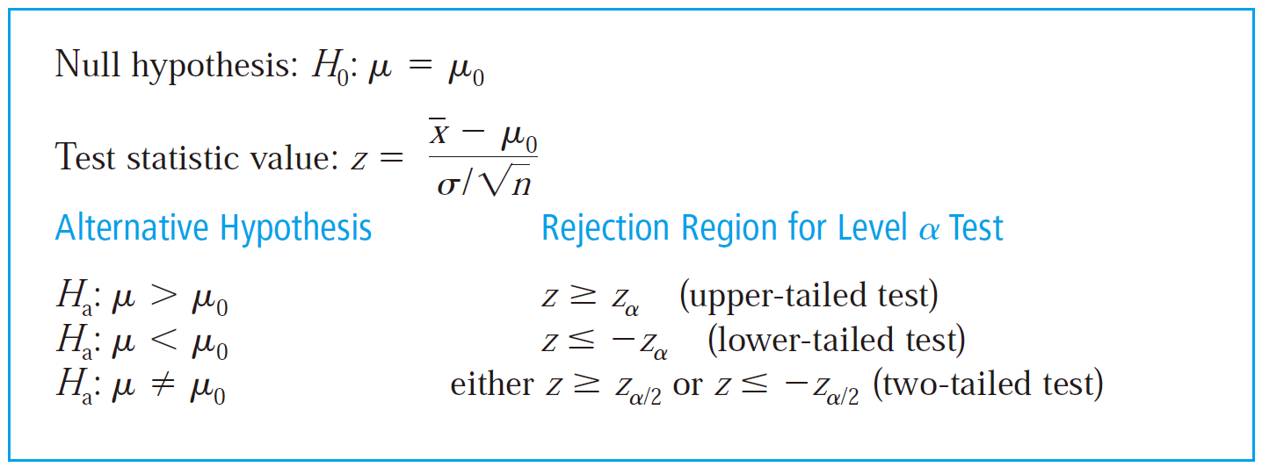
8.2. Tests About a Population Mean
Case I: A Normal Population with Known δ

Slide 25
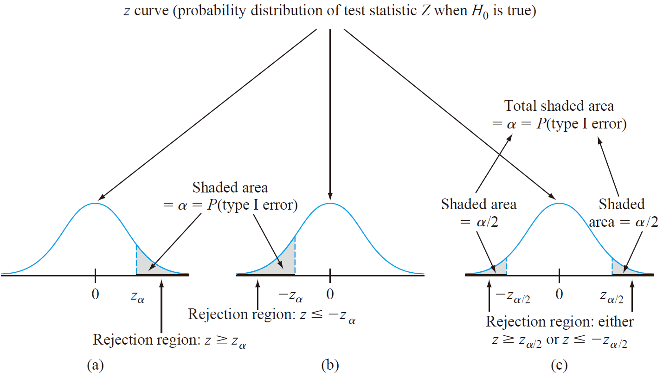
8.2. Tests About a Population Mean

Slide 26
8.2. Tests About a Population Mean
when testing hypotheses about a parameter:
Identify the parameter of interest and describe it in the context of the problem situation.
Determine the null value and state the null hypothesis. [should be done before examining the data]
State the appropriate alternative hypothesis. [should be done before examining the data]
Give the formula for the computed value of the test statistic (substituting the null value and the known values of any other parameters, but not those of any samplebased quantities).
State the rejection region for the selected significance level α.
Compute any necessary sample quantities, substitute into the formula for the test statistic value, and compute that value.
Decide whether H₀ should be rejected, and state this conclusion in the problem context.

Slide 27
8.2. Tests About a Population Mean
Example 8.6
A manufacturer of sprinkler systems used for fire protection in office buildings claims that the true average system-activation temperature is 130°F. A sample of n=9 systems, when tested, yields a sample average activation temperature of 131.08°F. If the distribution of activation times is normal with standard deviation 1.5°F, does the data contradict the manufacturer’s claim at significance level ?

Slide 28
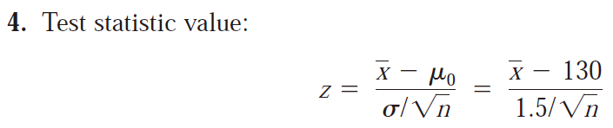
8.2. Tests About a Population Mean
Example 8.6 (Cont’)

Slide 29
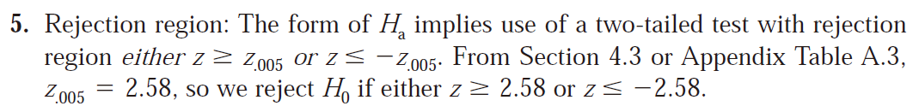
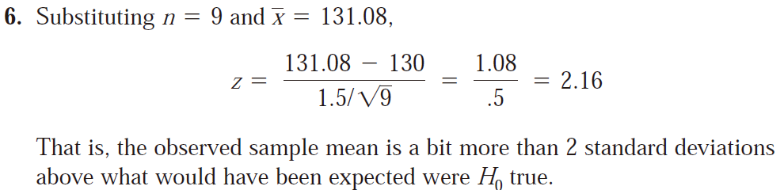
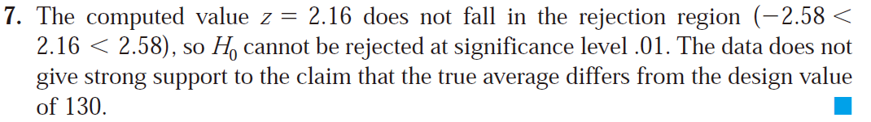
8.2. Tests About a Population Mean
Example 8.6 (Cont’)

Slide 30



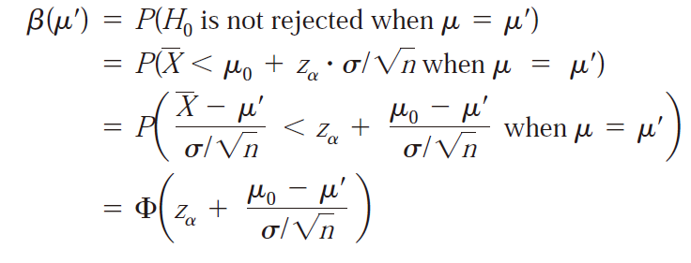
8.2. Tests About a Population Mean
β and Sample Size Determination
Consider first the upper-tailed test with rejection region
i.e.,
Thus H₀ will not rejected if
Denote a particular value of μ’ that exceeds the null value μ₀.

Slide 31
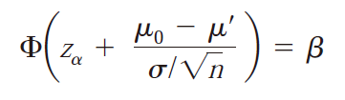
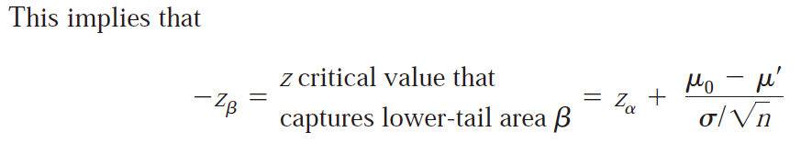
8.2. Tests About a Population Mean
More generally,

Slide 32
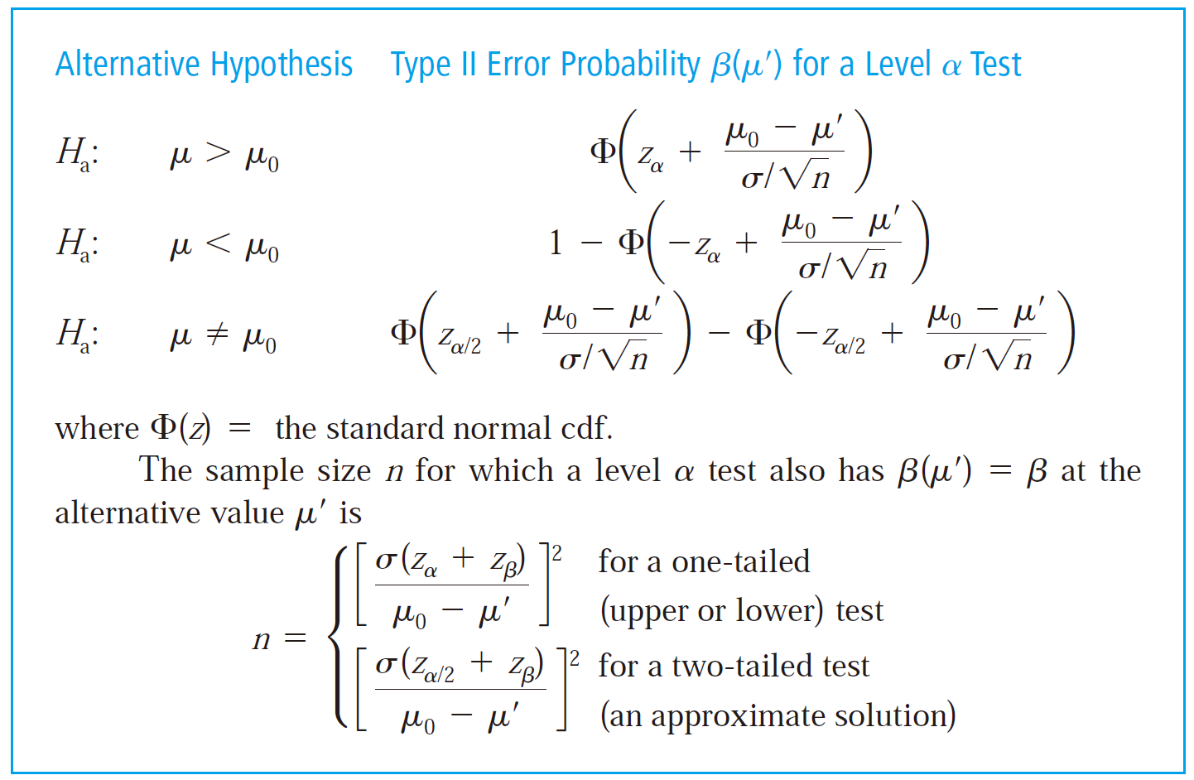
8.2. Tests About a Population Mean

Slide 33
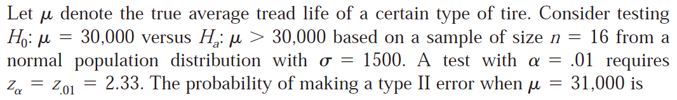
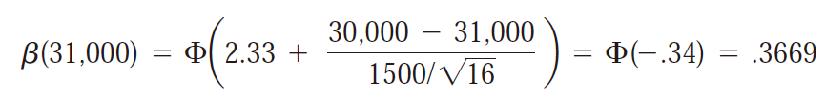
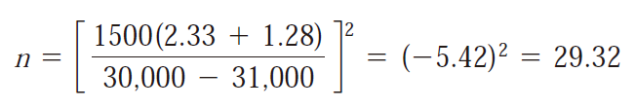
8.2. Tests About a Population Mean
Example 8.7
n=30

Slide 34
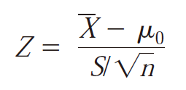
8.2. Tests About a Population Mean
Case II: Large-Sample Tests
When the sample size n is large (n>40), the z tests for case I are easily modified to yield valid test procedures without requiring either a normal population distribution or known σ.
has approximately a standard normal distribution
Similar to the Case I.

Slide 35
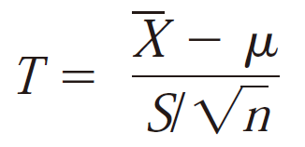
8.2. Tests About a Population Mean
Case III: A Normal Population Distribution
When n is small, the Central Limit Theorem (CLT) can no longer be invoked to justify the use of a large-sample test.
has a t distribution with degrees of freedom (df).

Slide 36
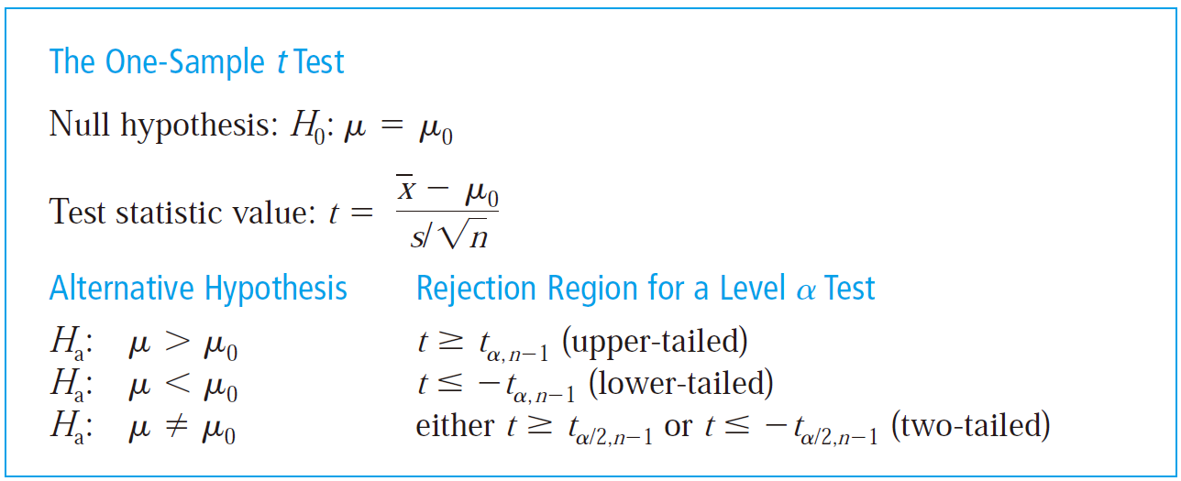
8.2. Tests About a Population Mean
Compared to the table in page 328.

Slide 37
8.2. Tests About a Population Mean
Homework
Ex. 15, Ex. 17, Ex. 18

